Slide 1

FC+: Near-optimal Deadlock-free Expander Data Center Networks
Xiao Zhang, Peirui Cao, Yongxi Lyu, Qizhou Zhang, Shizhen Zhao, Xinbing Wang, Chenghu Zhou
Notes:
I am Peirui Cao, a final-year PhD student at SJTU. Today, I will introduce our paper FC+, a near-optimal deadlock-free routing for expander networks.

Slide 2
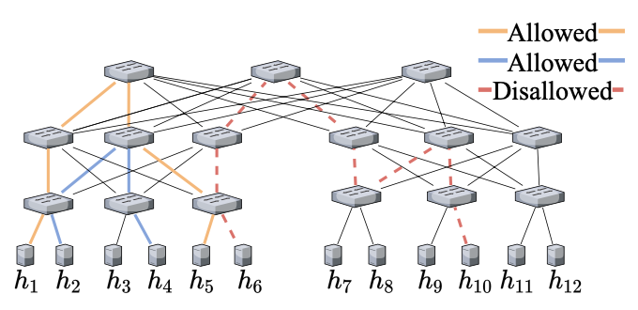
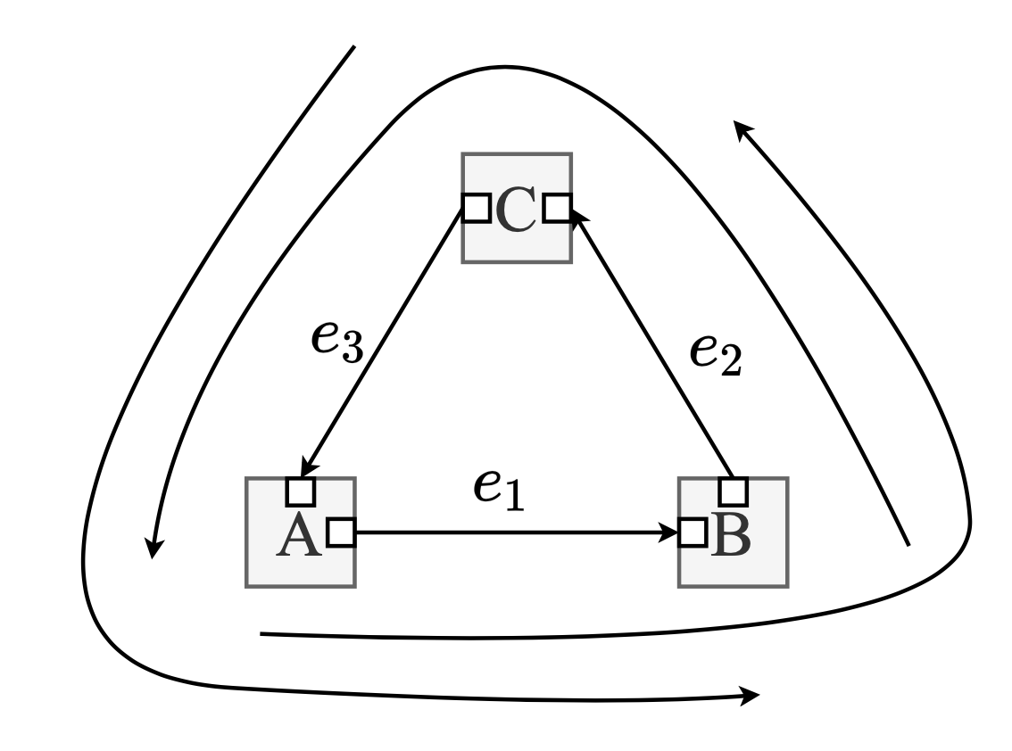
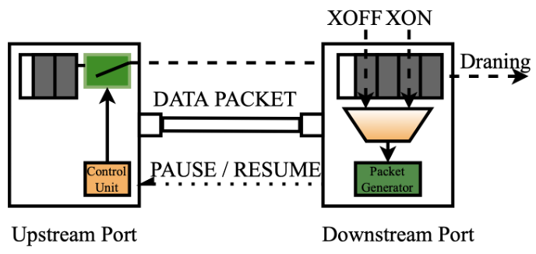
FC+ (Flattened Clos Plus)
Background
RDMA attains high throughput, low latency and CPU utilization.
Companies deployed RoCEv2 in data centers.
PFC -> cyclic buffer dependency (CBD) loops -> deadlock
RoCEv2 requires lossless.
Need to enable PFC to avoid congestion pkt loss.
A receives PFC
Up-down routing in (multi-layer) Clos is deadlock-free
Path direction: first-up-then-down
No first-down-then-up direction
C receives PFC
B receives PFC
Deadlock-free Key：
Eliminate CBD
Notes:
RDMA attains high throughput, low latency and CPU utilization. RDMA over Commodity Ethernet, namely RoCEv2, has gained significant traction in data centers. Many companies deployed RoCEv2, such as Microsoft, Alibaba, an so on.
RoCEv2 requires lossless networks.
Using PFC is helpful to avoid congestion packet loss.
PFC means The downstream switch sends a PAUSE frame to its upstream switch when its ingress queue length exceeds a certain XOFF threshold. At the time, the upstream port stop sending packets.
And then send a RESUME frame when the queue less than XON threshold. The upstream port can continue to send packets again.
However, the use of PFC in RoCEv2 can potentially introduce deadlocks when CBD exists.
CBD means multiple PFC generates a loop.
Using up-down routing can guarantee Clos layer-based topology can avoid deadlock.
Up-down routing only allow the routing direction first up and then down.
Look at the right figure, the orange and blue routing is up-down routing, but the red dashed routing is disallowed.

Slide 3
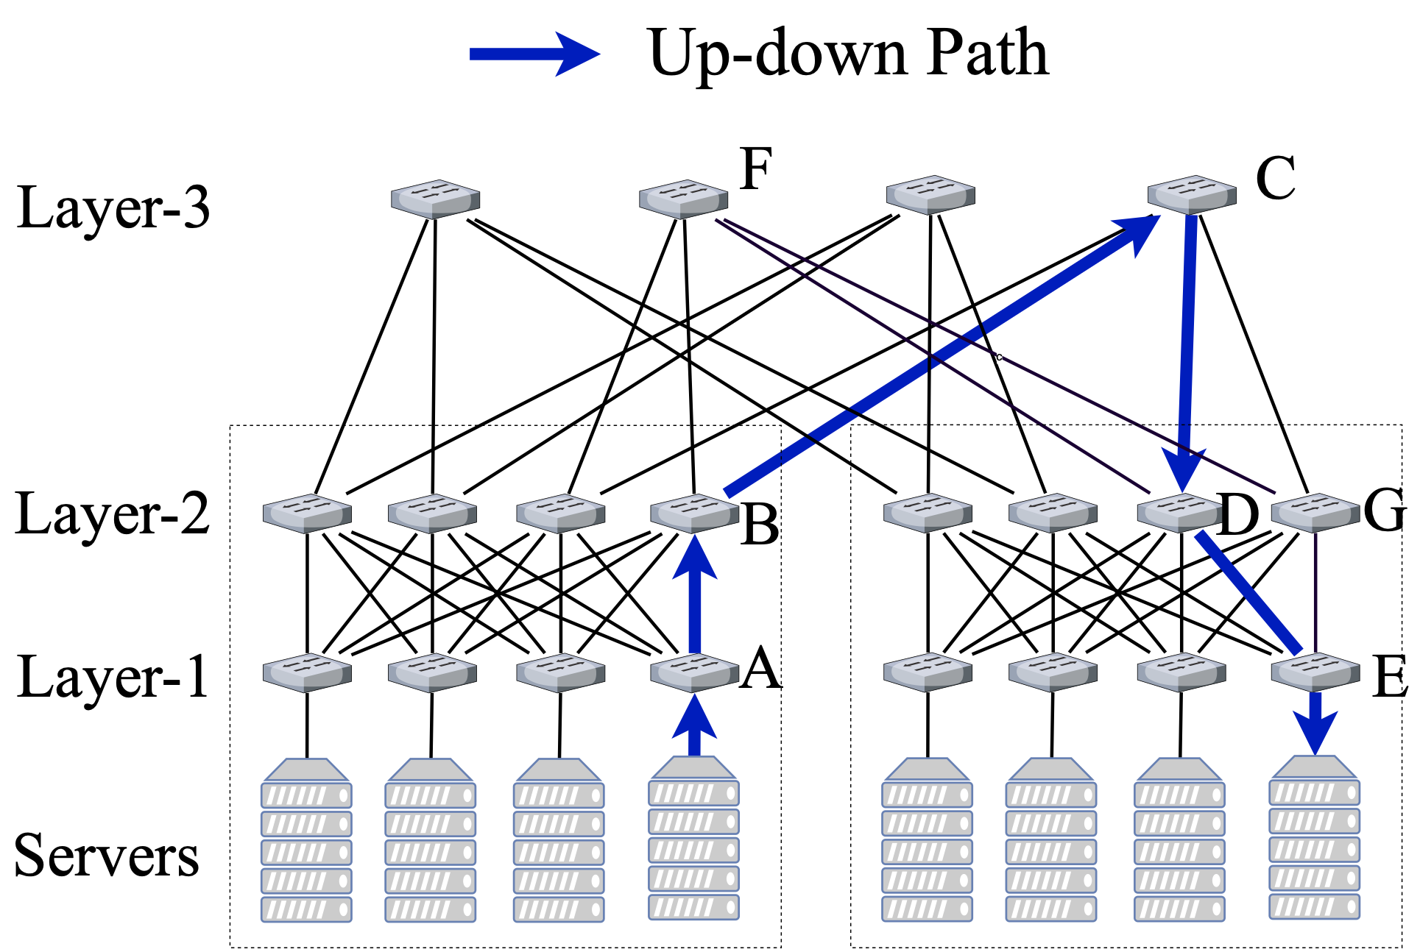
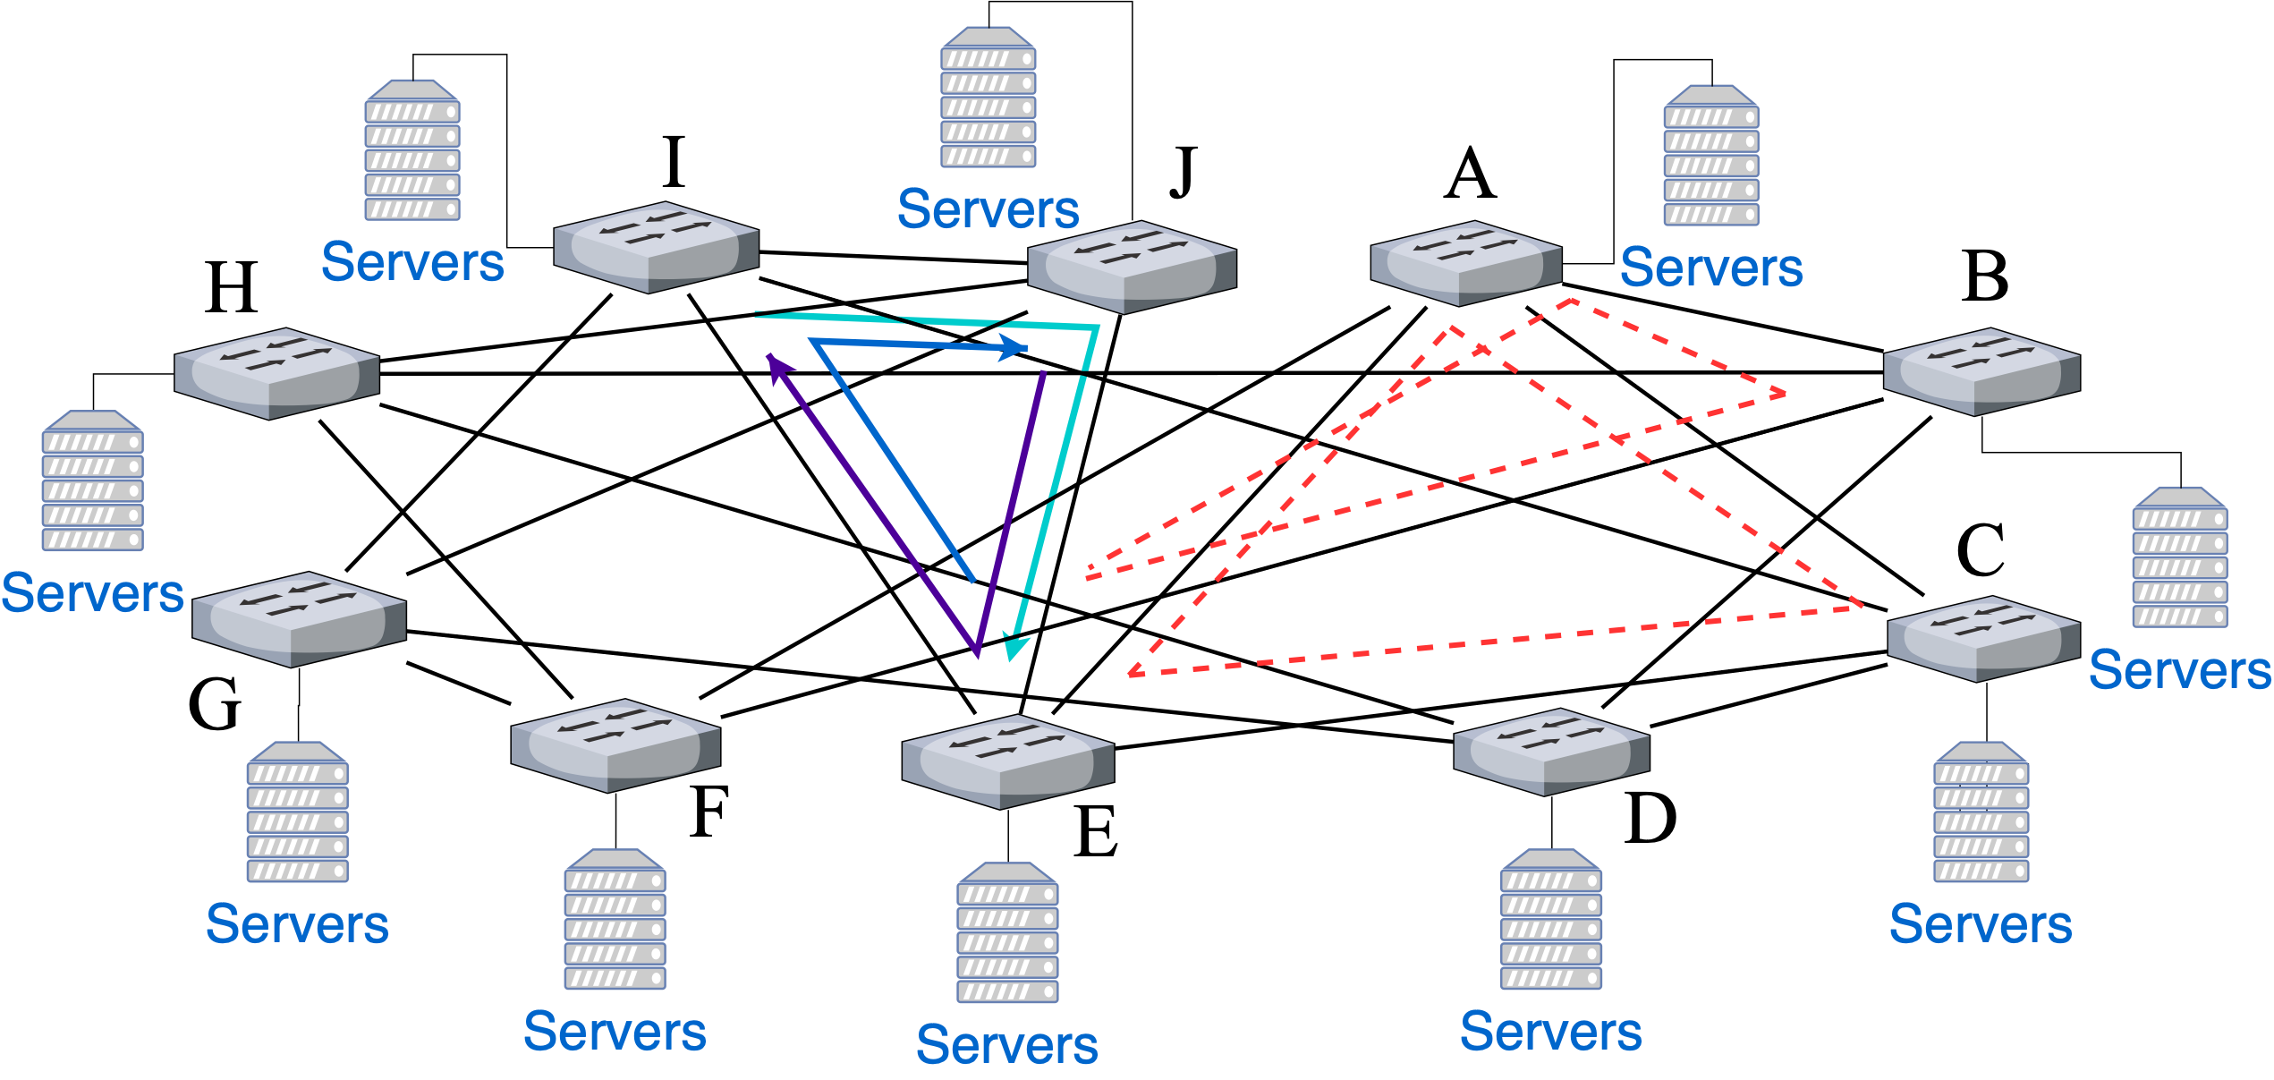
FC+ (Flattened Clos Plus)
Background
Clos: Cost-prohibitive even if no deadlocks
in up-down routing
Expander: Cost-efficient but contains
deadlocks in routing
How to design a deadlock-free routing in expander topology?
Notes:
However, Clos topology is cost-prohibitive even if there are no deadlocks in routing.
In contrast, expander topology like Jellyfish, Xpander is cost-efficient but contains deadlocks in routing
As shown in right figure, the frequently-used ECMP or KSP routing are not CBD-free in expander topology. Many CBD loops can have deadlocks.
Therefore, we need to consider how to design a deadlock free routing in expander topology.

Slide 4
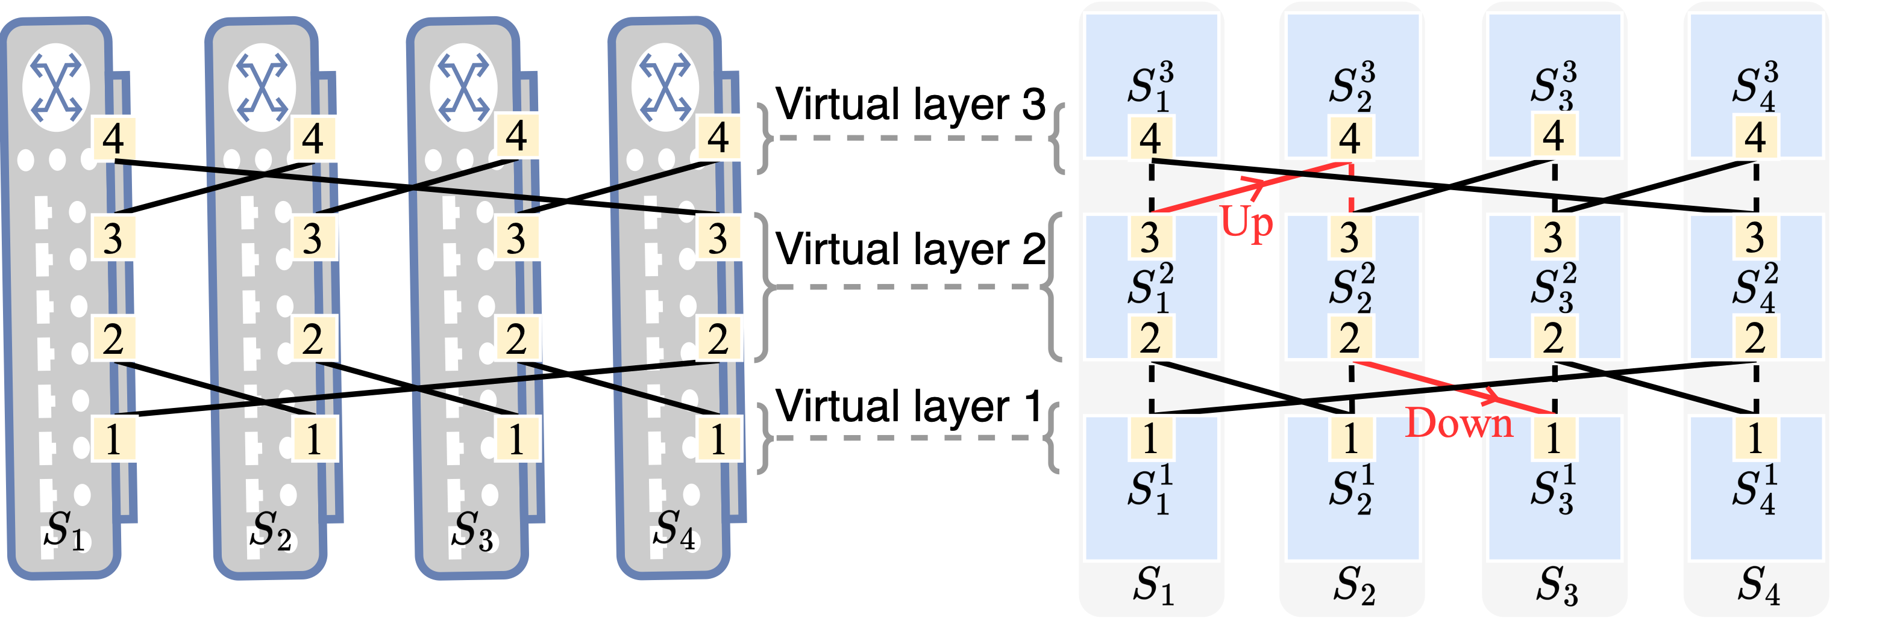
FC+ (Flattened Clos Plus)
Existing deadlock-free state-of-the-art work: FC (Flattened Clos)
Expander topology with 4 ToR switches ,
each switch has 4 ports connected to other switches
Split each switch into 3 virtual switches,
build the virtual topology with 3 layers
Shizhen Zhao, Qizhou Zhang, Peirui Cao, Xiao Zhang, Xinbing Wang, Chenghu Zhou, "Flattened Clos: Designing High-performance Deadlock-free Expander Data Center Networks Using Graph Contraction," in NSDI, Boston, MA, USA, April, 2023.
Notes:
The state-of-the-art method to avoid deadlocks in expander topology is FC, it is our previous work published in NSDI 2023.
Because this paper FC+ is related to FC, We want to introduce the core idea of FC first.
Let’s look the toy expander topology with 4 ToR switches. Each switch has 4 ports connected to other switches.
FC splits each ToR switches into 3 virtual switches and assign them to 3 virtual layers accordingly.
FC allows paths in the up direction from a lower layer to a higher layer, such as S_1^2, to S_2_3.
Similarly, allow paths in the down direction from a higher layer to a lower layer, such as S_2^3 to S_2^2 to S_3_1.
Among all up-down paths between each switch pair, FC’s routing only use edge disjoint up-down path. It can avoid deadlock in expander topology.

Slide 5
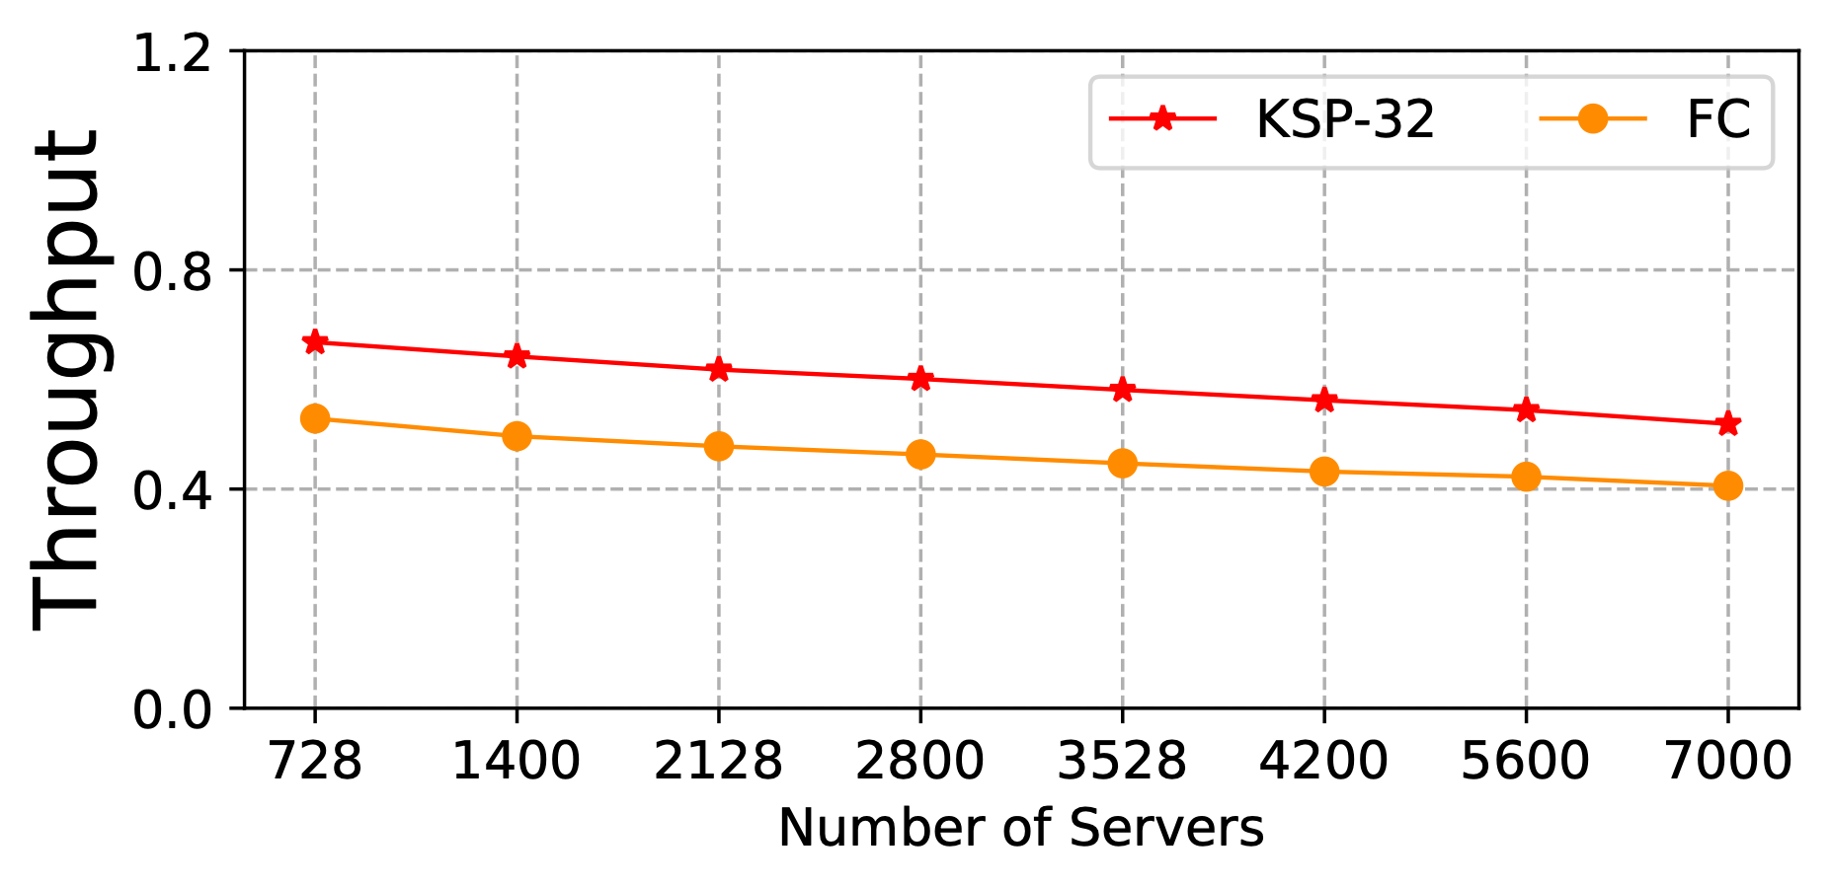
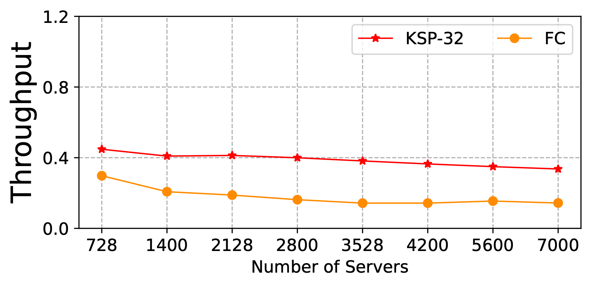
FC+ (Flattened Clos Plus)
Throughput loss of FC and FC+’s motivation
Uniform random traffic pattern
Near-worst case traffic pattern
Calculate the throughput of Ideal KSP as baseline. In fact, real KSP can cause deadlock.
Target: FC+ motivates designing deadlock-free routing
without performance loss
Notes:
However, we can see from the figure, the throughput gap between FC and ideal KSP is not small.
Note that, here we calculate the throughput of ideal KSP with God perspective to get the optimal value. In fact, KSP can cause deadlock. It's dangerous.
So our FC+ target is to design deadlock-free routing without performance loss.

Slide 6
FC+ (Flattened Clos Plus)
Contribution
FC+ finds the reason of throughput gap between FC and ideal KSP.
FC+ proposes non-uniform virtual multi-layer topology to add path diversity.
FC+ proposes deadlock-free KSP (DF-KSP) routing to guarantee deadlock free and high throughput.
FC+ only needs 2 lossless priority queues to loosen up-down constraints for path diversity. Other deadlock-free methods require more queues, which poses a challenge due to the constrained buffer space.
Notes:
Here, I briefly describe our contribution.

Slide 7
FC+ (Flattened Clos Plus)
Analyze the bottleneck of FC
Num. of switches in network | Average num. of available up-down paths | Average num. of disjoint up-down paths | Links connected to other switches
100 | 31.67 | 6.48 | 18
200 | 16.07 | 5.01 | 18
300 | 10.78 | 4.22 | 18
400 | 22.83 | 4.92 | 18
Too few
Both FC’s virtual topology and routing have very poor path diversity.
The designs of FC impair path diversity, we need to redesign all of them !
Notes:
We first need to analyze the bottleneck of FC.
We caculate the average number of different paths in FC topology and routing.
Find that the bottleneck for FC’s poor performance is poor path diversity.
That means FC can guarantee deadlock-free, but only have a small fraction of available paths.
The topology and routing designs of previous FC impair path diversity, therefore, we need to redesign all of them.

Slide 8
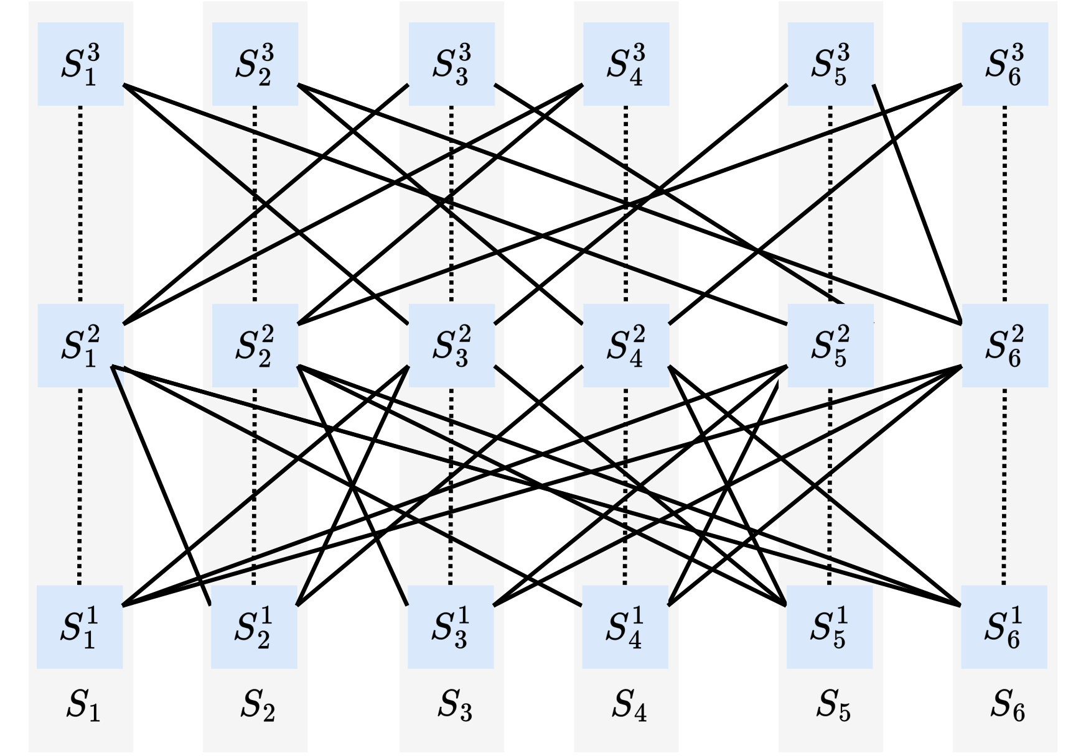
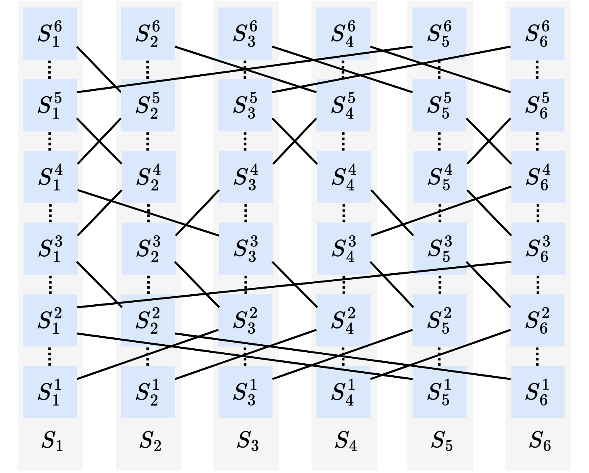
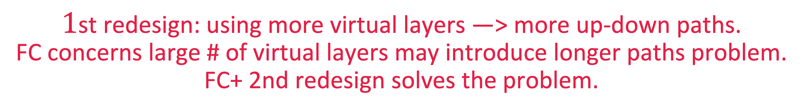
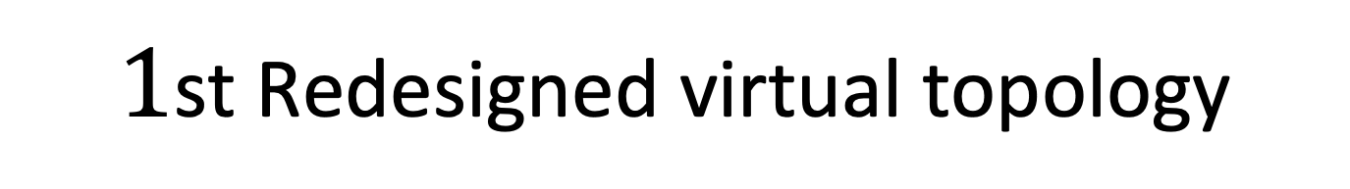
From FC to FC+ (Improve path diversity in topology)
Redesign of virtual multi-layer topology
FC virtual topology
$1$st Redesigned virtual topology
$1$st redesign: using more virtual layers —> more up-down paths.
FC concerns large # of virtual layers may introduce longer paths problem.
FC+ 2nd redesign solves the problem.
Notes:
In FC+, we redesign the virtual topology first.
The first redesign is to increase the number of virtual layers.
More virtual layers mean more up-down routing paths.
In the example, we increase the number of virtual layers from three to six.
In previous FC, we concerns larger number of layers may introduce longer paths in routing. But in FC+, we allow more virtual layers and use 2nd redesign to solve the problem.

Slide 9
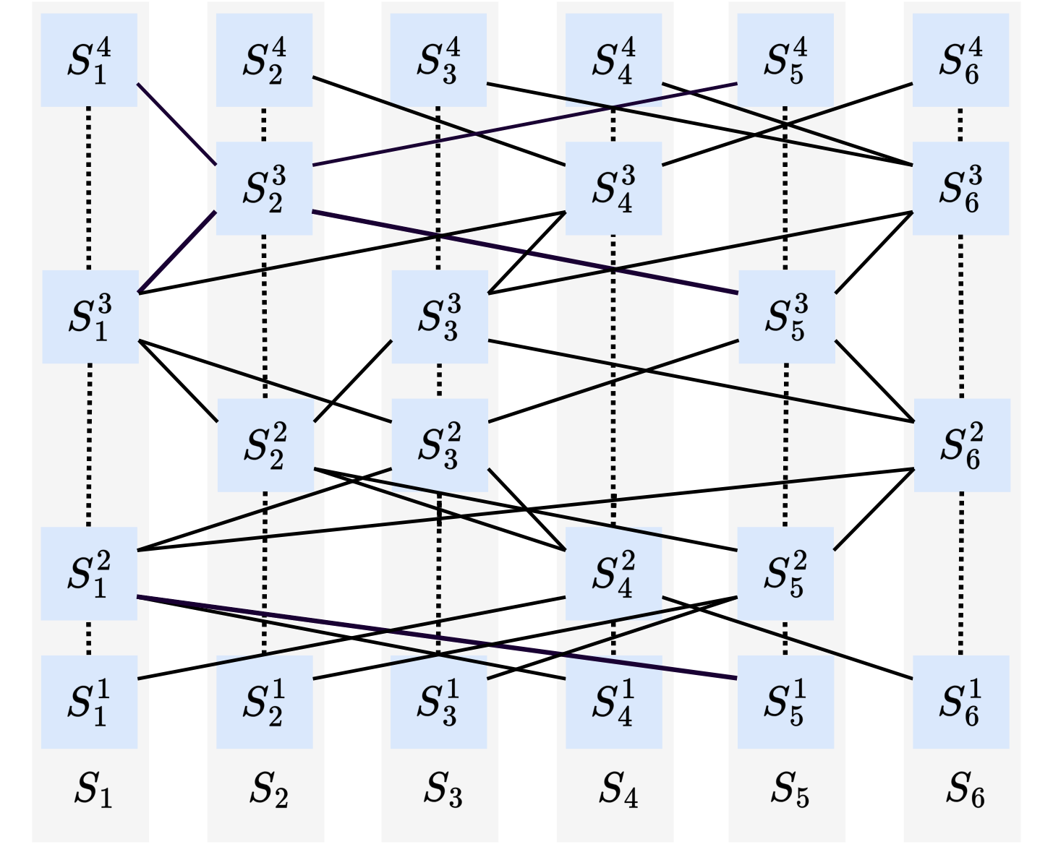
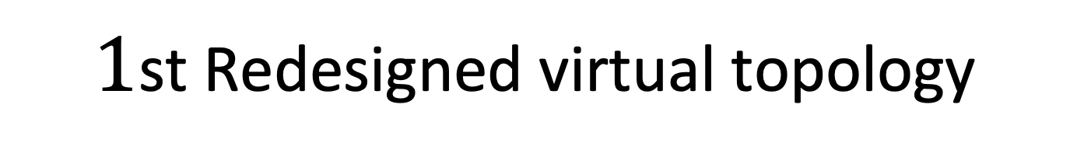
From FC to FC+ (Improve path diversity in topology)
Redesign of virtual multi-layer topology
# of virtual switches ≤ # of virtual layers
$1$st Redesigned virtual topology
2nd Redesigned virtual topology
2nd redesign: Reduce virtual switches —> increase the links of connecting other switches -> enhance forward ability of some virtual switches
Notes:
The second redesign is to reduce the number of virtual switches to increase the links of connecting other switches and thus the forward ability of virtual switches is enhanced.
In the left figure, when we use larger number of virtual layers, each virtual switch has at most 2 links connected to other switches. In the right figure if we reduce the number of virtual switches, the connection ability of some virtual switches will be increased.
Different with the constraint of FC, FC+ allows the number of virtual switches could less than the number of virtual layers.

Slide 10
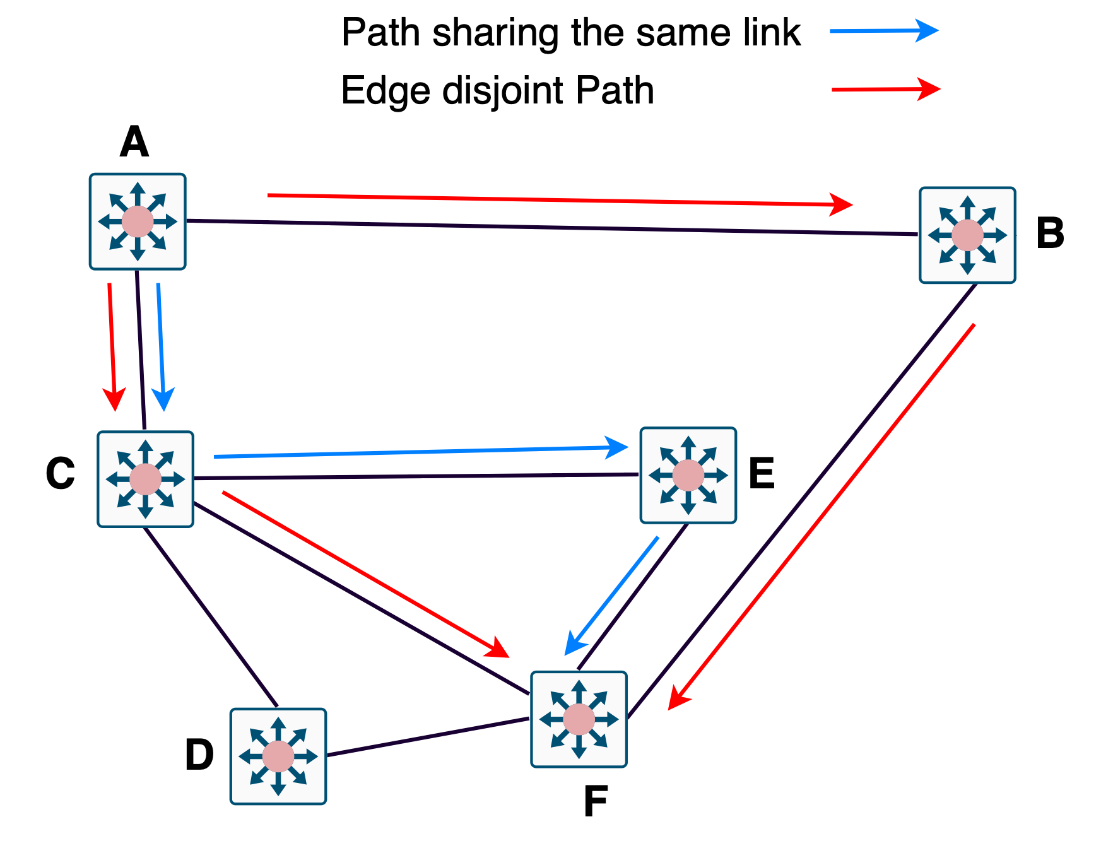
From FC to FC+ (Improve path diversity in routing)
There are many paths between each virtual switch pair, how to pick from them?
Previous FC uses edge disjoint routing : all the paths between each switch pair can not share the same link.
Due to edge disjoint constraint on up-down paths, FC can only use less number of paths for routing.
Notes:
FC uses edge disjoint routing.
As shown in the figure, two red paths are edge disjoint paths, while all the three paths are not edge disjoint because blue path shares the same link with red one.
In the example, from A to F, due to edge disjoint constraint, only 2 paths (ACF and ABF) can be used.
Similarly, in FC, due to the constraint, FC can only use limited number of paths.
Due to edge disjoint constraint on up-down paths, we can only use less number of paths for routing.

Slide 11
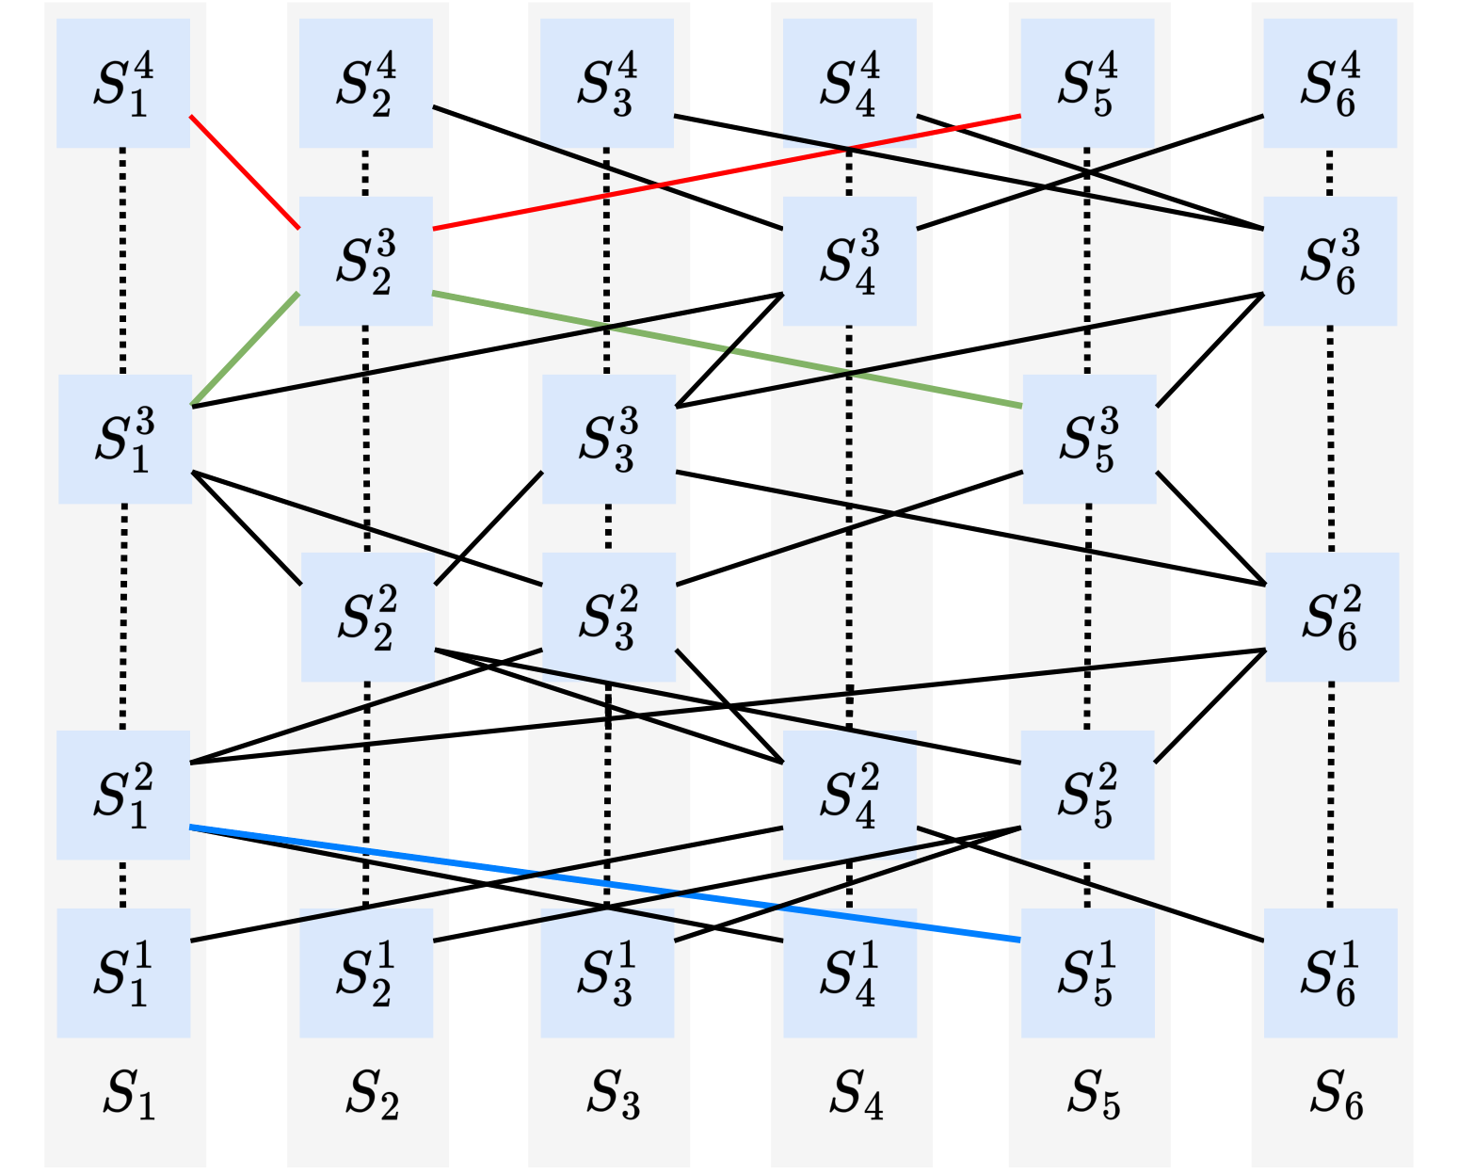
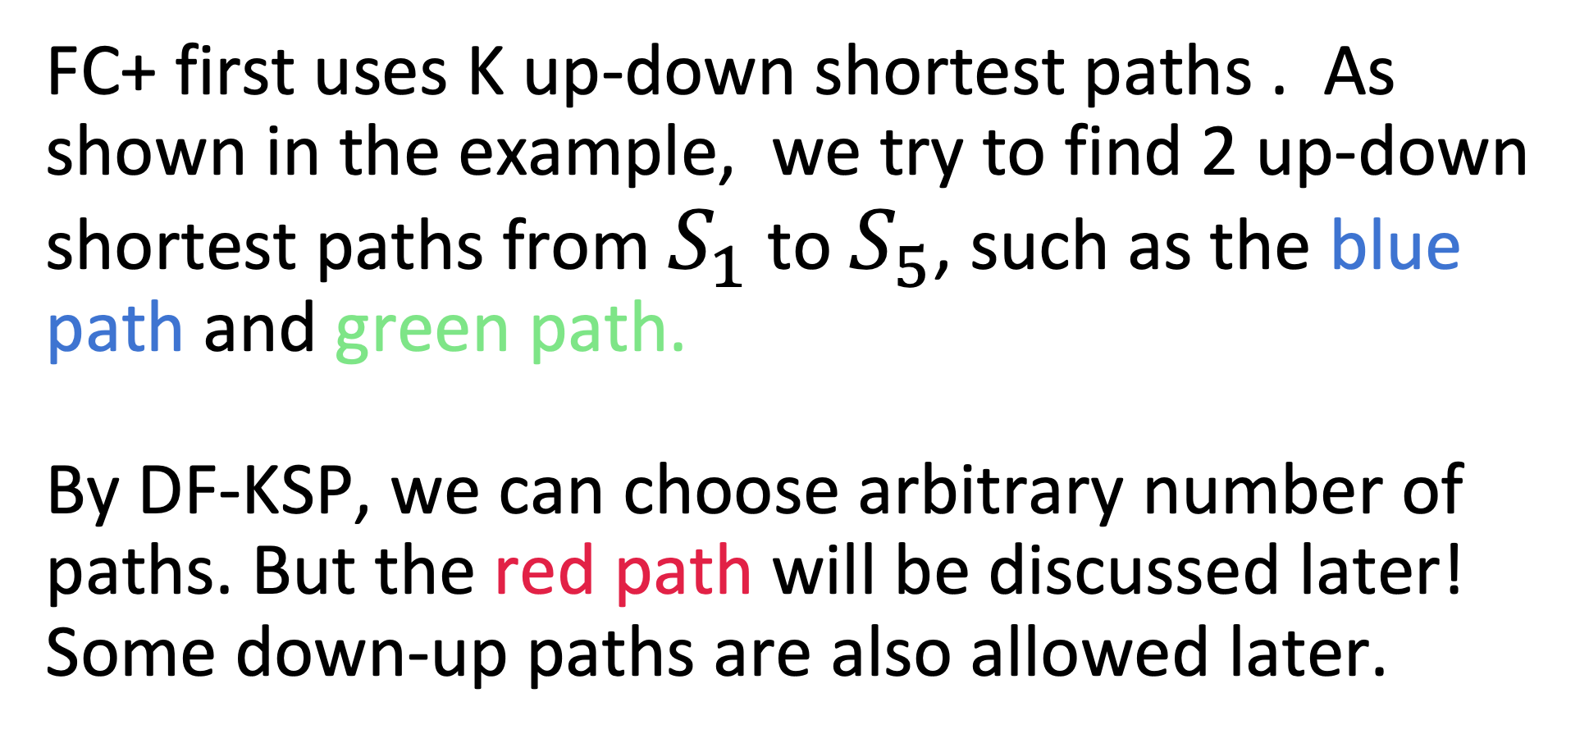
From FC to FC+ (Improve path diversity in routing)
From edge disjoint to deadlock-free KSP(DF-KSP)
FC+ first uses K up-down shortest paths . As shown in the example, we try to find 2 up-down shortest paths from $S_{1}$ to $S_{5}$, such as the blue path and green path.
By DF-KSP, we can choose arbitrary number of paths. But the red path will be discussed later!
Some down-up paths are also allowed later.
Notes:
In FC+, We use deadlock-free KSP routing, which means we pick up-down paths from the deadlock-free K shortest paths.
As the figure shown, from S1 to S5, there are many up-down paths, we choose the 2 shortest paths first, like blue one hop path and green two hop paths.
Both of them. meet the strong up-down routing constraint By deadlock-free KSP, we can choose arbitrary number of paths. But The red path will be discussed later.

Slide 12

FC+ experiment setup
Some experiments based on mathematics.
Some experiments based on HPCC and FC repositories using NS-3.
500 ToR switches. Each ToR is connected to 18 other switches and 14 servers. 4 virtual switches , 10 virtual layers.
2000 ToR switches. Each ToR is connected to 22 other switches and 10 servers. 4 virtual switches , 12 virtual layers.
Port rate : 25Gb/s; enable DCQCN.
3 types of traffic patterns.
All-to-all.
Uniform random.
Near-worst case.
Notes:
Our simulation experiments are based on mathematics or HPCC and FC repositories using NS3 simulator.
We use different topology and traffic patterns to evaluate our design.
Due to time constraints, we only present partial evaluations in this talk.

Slide 13
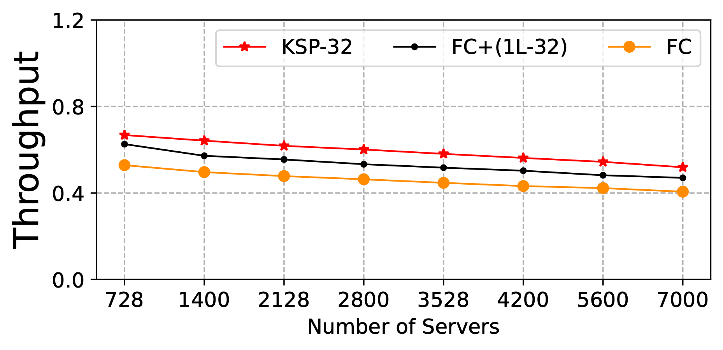
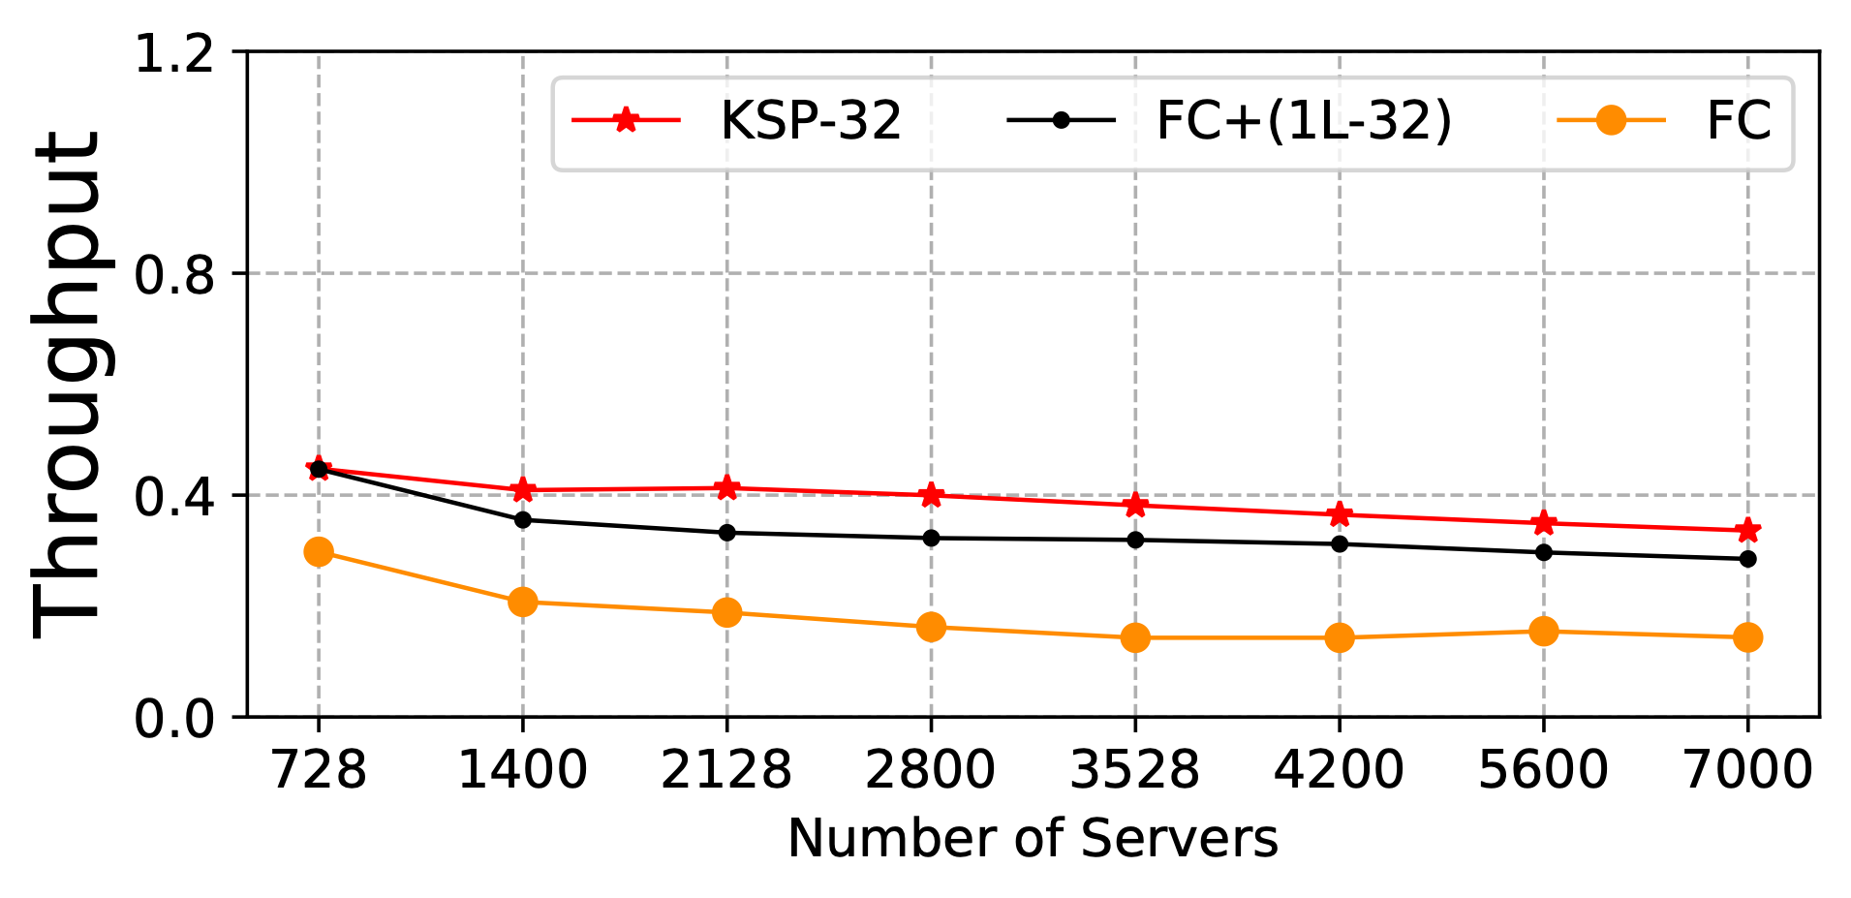
From FC to FC+ (evaluation on throughput)
Uniform random traffic pattern
Near-worst case traffic pattern
FC+ ($1L−32$) means FC+ uses $1$ lossless priority and use $32$ paths
FC+ still has a small gap compared to ideal KSP, how to reduce the gap ???
Notes:
We evaluate our redesigns of FC+ using 1 lossless priority.
FC+’s throughput outperforms FC but still has a small throughput gap with KSP.
How to reduce the gap?

Slide 14
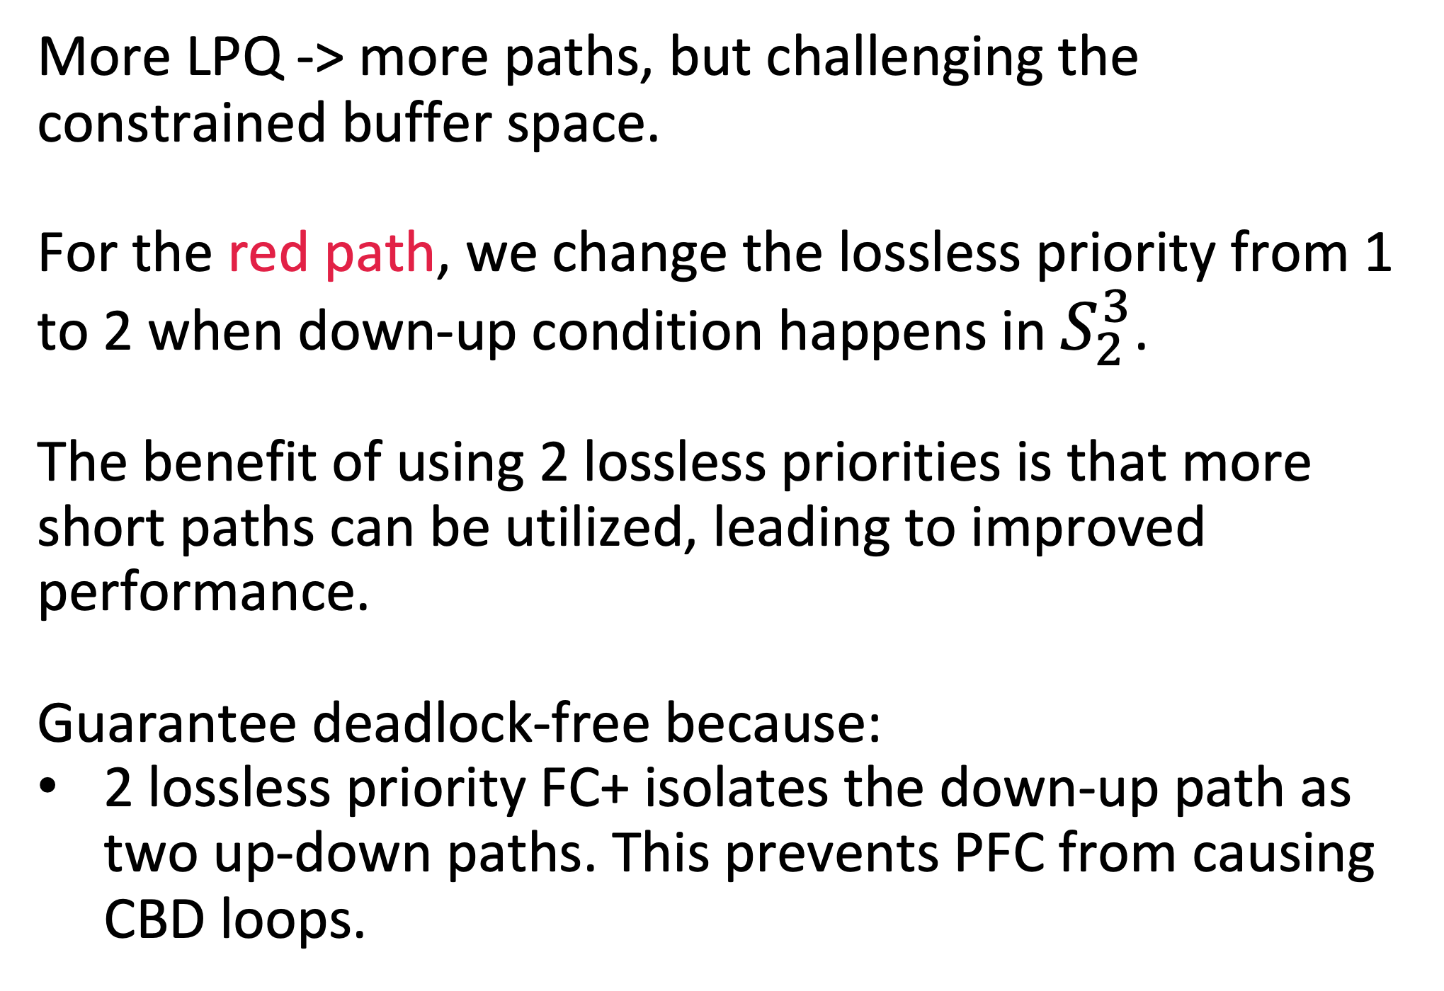
From FC to FC+
Introduce 2 Lossless Priority Queue (LPQ) compared to FC
Reduce LPQ from x to 2 compared to others [1]
More LPQ -> more paths, but challenging the constrained buffer space.
For the red path, we change the lossless priority from 1 to 2 when down-up condition happens in $S_{2}^{3}$.
The benefit of using 2 lossless priorities is that more short paths can be utilized, leading to improved performance.
Guarantee deadlock-free because:
2 lossless priority FC+ isolates the down-up path as two up-down paths. This prevents PFC from causing CBD loops.
[1] Shuihai Hu, Yibo Zhu, Peng Cheng, Chuanxiong Guo, Kun Tan, Jitendra Padhye, and Kai Chen, "Tagger: Practical PFC deadlock prevention in data center networks," in CoNEXT, 2017.
Notes:
If we can use more lossless priority queue, we can use more paths, but even if there are 8 priorities for RDMA, the real RoCEv2 networks can only support at most 2 or 3 lossless priorities due to the constrained buffer space.
Other works use more queues to avoid deadlock, but it is impractical because of the the constrained buffer space.
Now. We use the 2 lossless priority in FC+ to allow some deadlock-free down-up path to improve the throughput.
For the red path, we change the lossless priority from 1 to 2 when down-up condition happens in S_2^3
The benefit of using two lossless priorities is that more short paths can be utilized, leading to improved throughput performance.
At the same time, FC+ with 2 lossless priority isolates the down-up path as two up-down paths. This prevents PFC from causing CBD loops, so it guarantees deadlock-free routing.

Slide 15
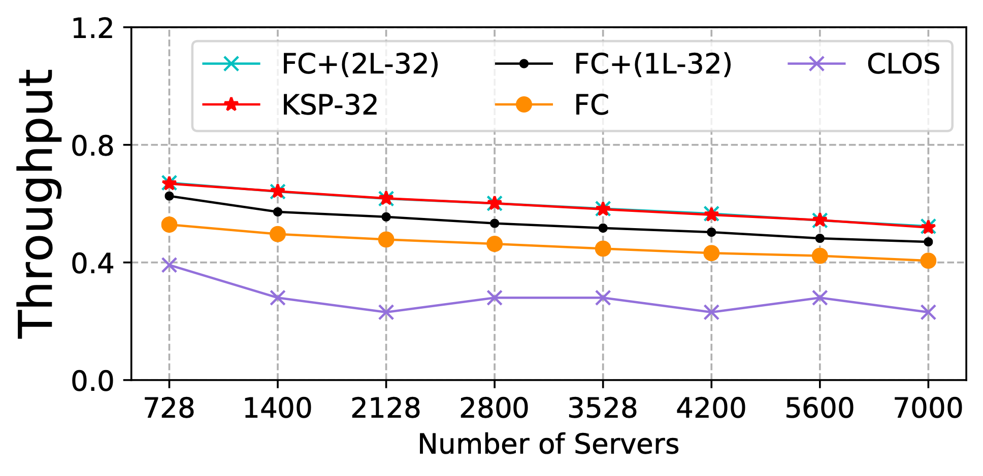
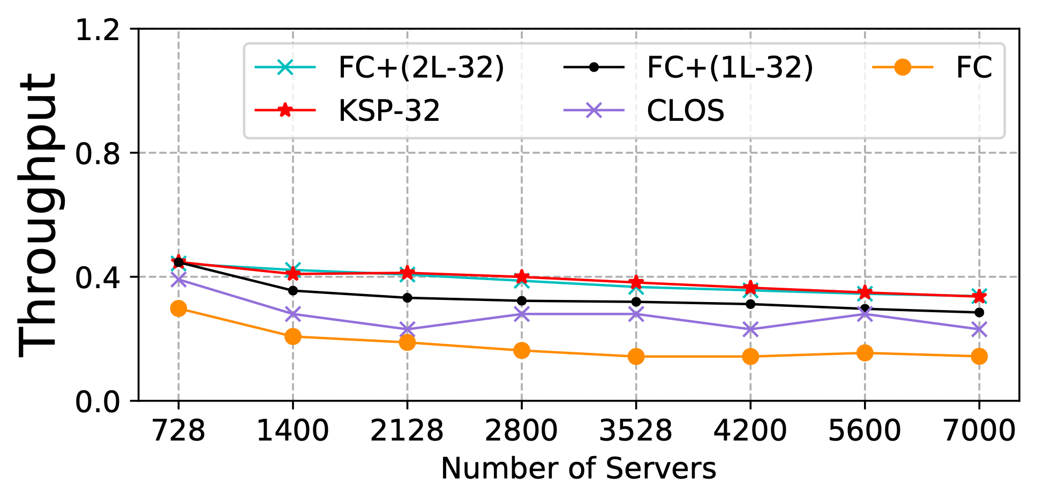
FC+ (Flattened Clos Plus)
Evaluation
Uniform Random traffic pattern
Near-worst traffic pattern
FC+ with 2LPQ achieves optimal throughput comparable to ideal KSP with God perspective.
In fact, real KSP can cause deadlock.
Besides non-uniform virtual layers, FC+ with 2LPQ guarantees no deadlock and is good for path diversity → Good throughput.
Notes:
We evaluate our design again. FC+ with 2 lossless priority can achieve near-optimal throughput performance and guarantee no deadlock.
Besides non-uniform virtual layers, FC+ with 2 lossless priority is also good for path diversity leading to good throughput.

Slide 16
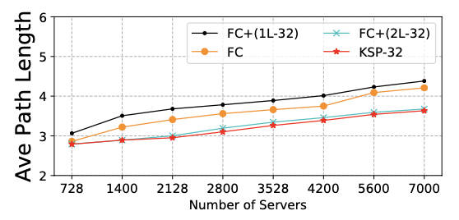
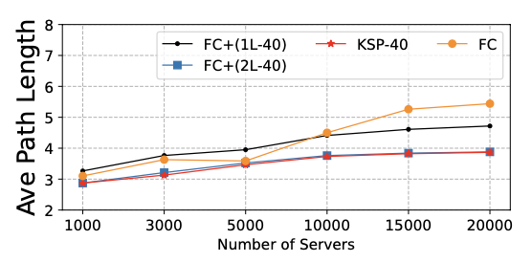
FC+ (Flattened Clos Plus)
Evaluation
500 ToR switches
2000 ToR switches
FC+ with 2LPQ achieves near-optimal average path length
benefiting from loosening up-down routing constraints using 2LPQ.
Notes:
In addition, if we allow some down-up path to loosen up-down routing constraints using 2 lossless priority, the FC+ will achieve near-optimal average path length performance.

Slide 17
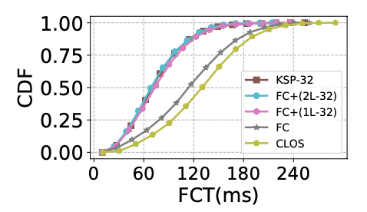
FC+ (Flattened Clos Plus)
Evaluation
Near-worst traffic pattern (workload = 0.7)
FC+ achieves near-optimal FCT performance.
The limited path diversity of FC leads to a noticeable performance gap compared to FC+.
Notes:
Under the near-worst traffic pattern, the flow completion time performance of FC+ is near-optimal. And the limited path diversity of FC leads to a noticeable performance gap compared to FC+.
Other experiments please to see our paper.

Slide 18
FC+ (Flattened Clos Plus)
Conclusion
FC+ outperforms state-of-the-art FC 1.4~2X in near-worst case and achieve near-optimal deadlock-free routing in expander networks under all traffic patterns.
New design of non-uniform virtual multi-layer topology
Deadlock-free KSP (DF-KSP) routing
Reduce LPQ from x to 2 to improve DF-KSP compared to other impractical more LQP designs.

Slide 19

Thank you!

